Slide 1
Module 3: Creating Calculations and Measures

Slide 2
Learning Objectives
Objective: Introduce basic calculations and measures
Topics Covered:
Introduction to calculations
Creating calculated columns and basic measures (e.g., total crime count, crime rates).
Using level of details and parameters
Basic filtering and aggregations

Slide 3
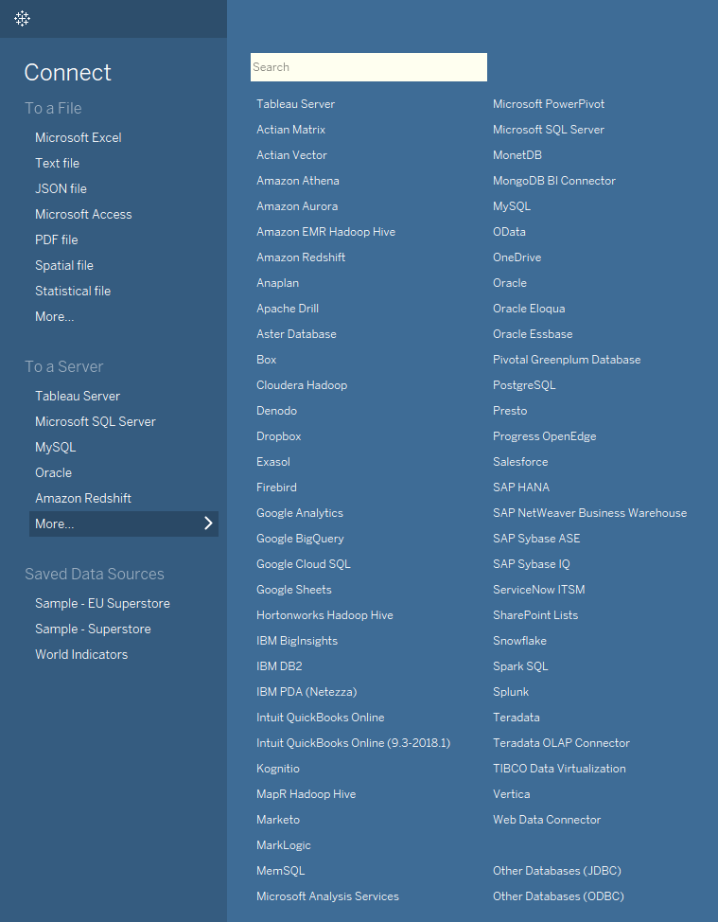
Tableau Desktop Getting Started!

Slide 4
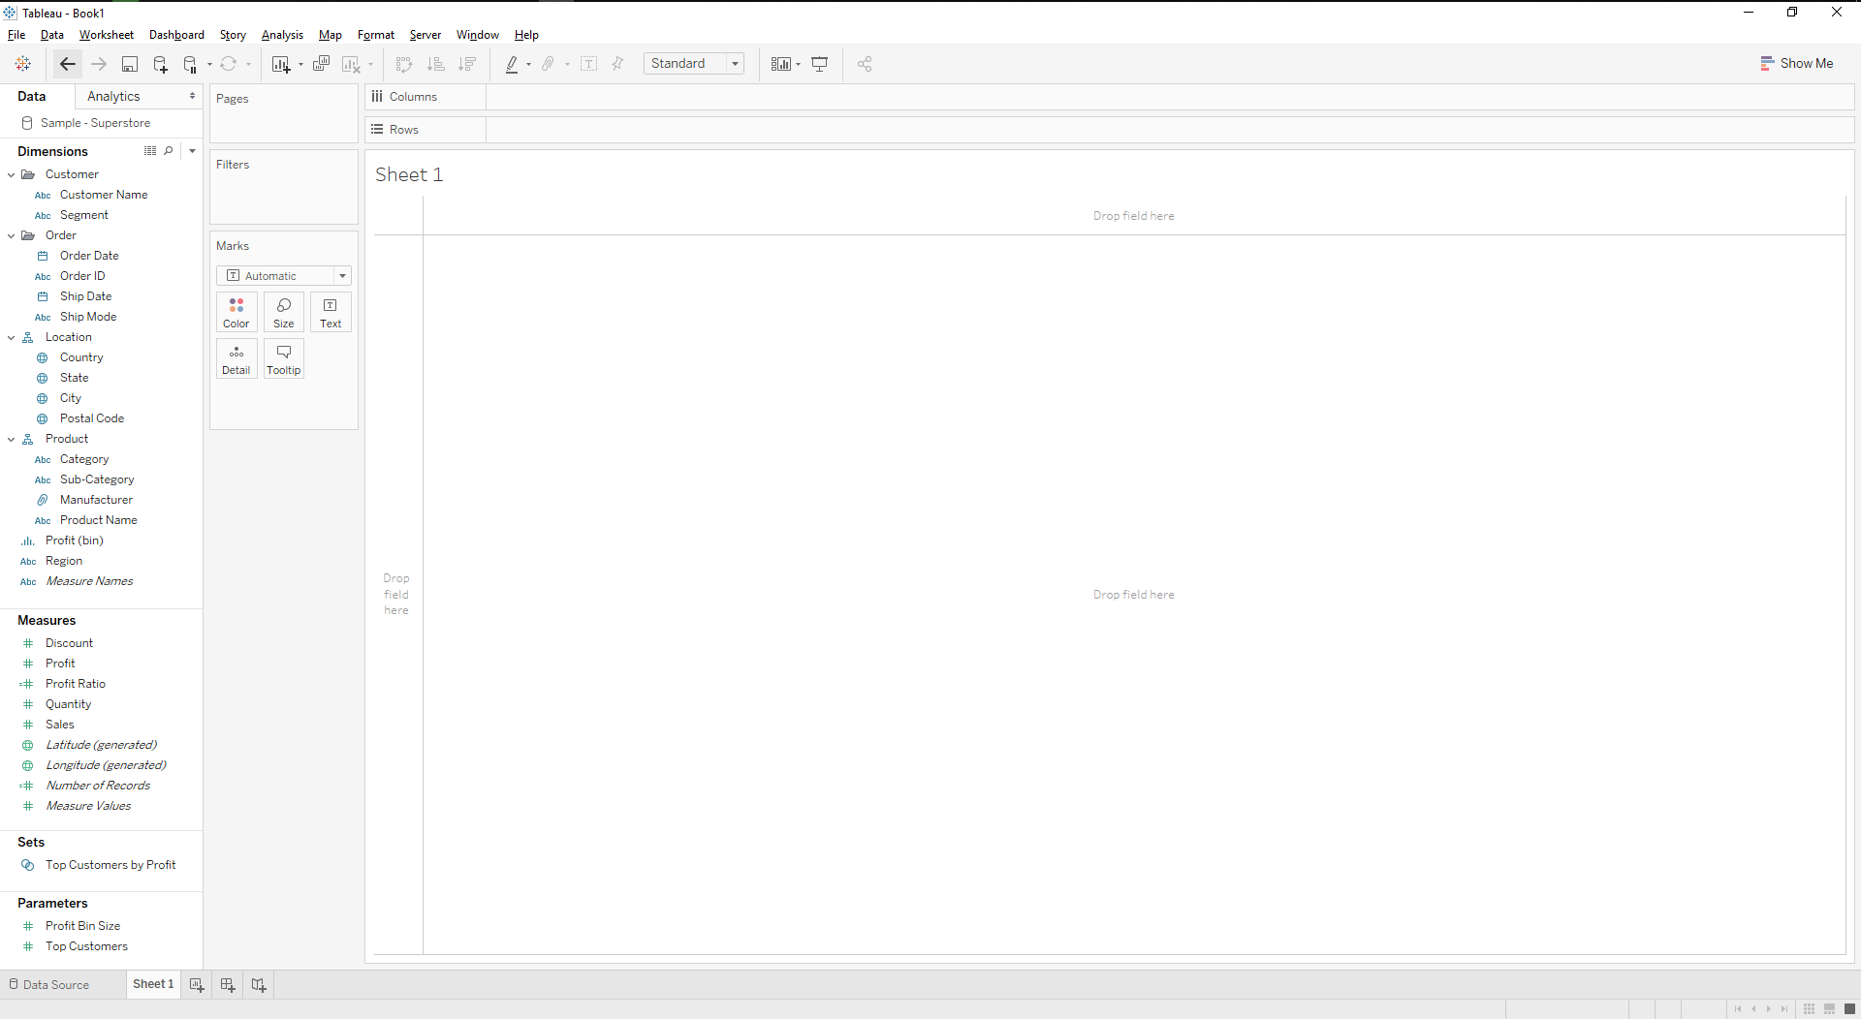
Tableau Desktop Interface

Slide 5
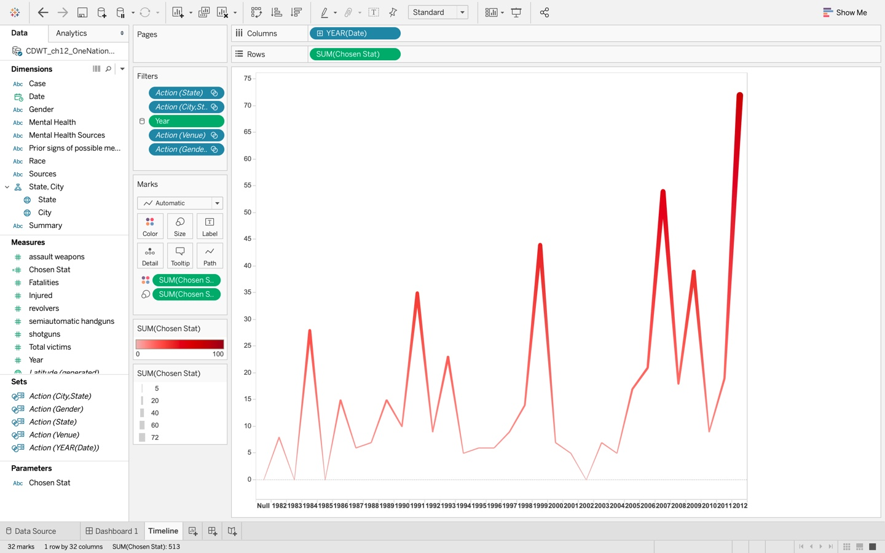
Dimensions and Measures
Dimensions are Descriptive and are shown in blue.
Examples: Gender, Summary, City.
Measures are Metrics and are shown in green.
Examples: Total Victims, Fatalities, Injured

Slide 6
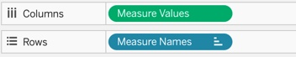

Fields are “pills”
This Photo by Unknown Author is licensed under CC BY-SA-NC

Slide 7
Tableau and Data Preparation
Creating Parameters
Level of Detail
Calculated Fields

Slide 8
Creating Parameters
The parameters in Tableau are the workbook variables like a number, date, or calculated field that allows users to replace a constant value in a calculation, filter, or reference line.
With the parameter control, users can dynamically vary the threshold values in their calculation.

Slide 9
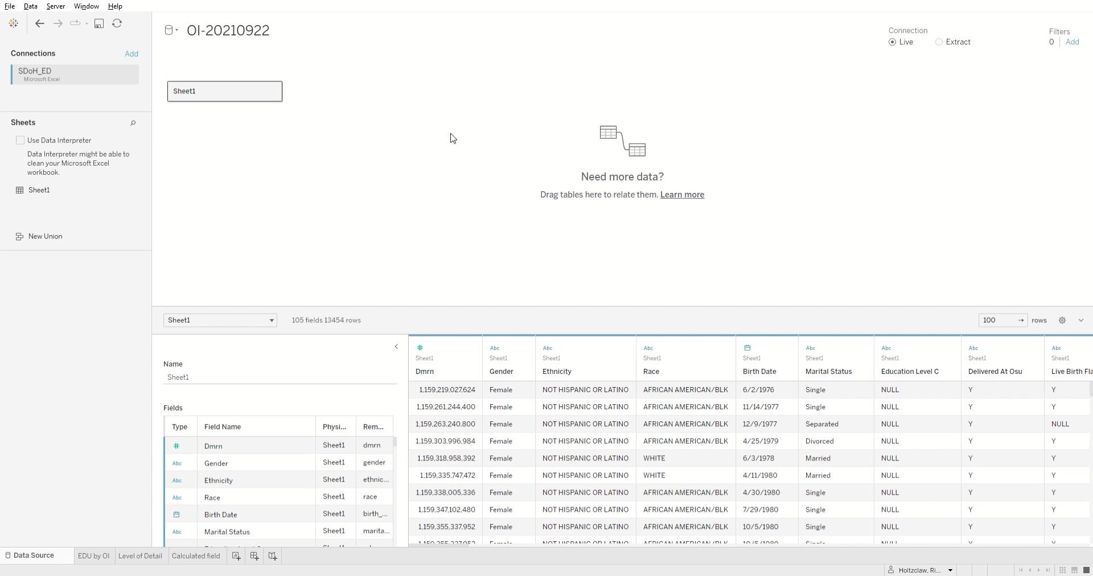
Parameters
Median OI score by city
Create parameter that displays the top 5, top 10, top 15 cities by median OI score

